Slide 1
Principal Component Analysis (PCA)
Sourav Karmakar
souravkarmakar29@gmail.com

Slide 2
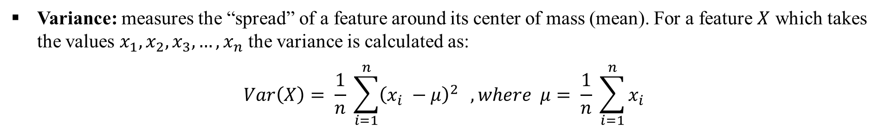
Variance And Covariance
Variance and Covariance are the measures of “spread” of a set of points around their center of mass (mean).
X₁ | x₁⁽¹⁾ | x₁⁽²⁾ | x₁⁽³⁾ | . . . | x₁^{(n-2)} | x₁^{(n-1)} | x₁^{(n)}
X₂ | x₂⁽¹⁾ | x₂⁽²⁾ | x₂⁽³⁾ | . . . | x₂^{(n-2)} | x₂^{(n-1)} | x₂^{(n)}

Slide 3
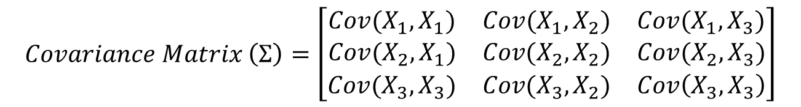

Covariance Matrix

Slide 4


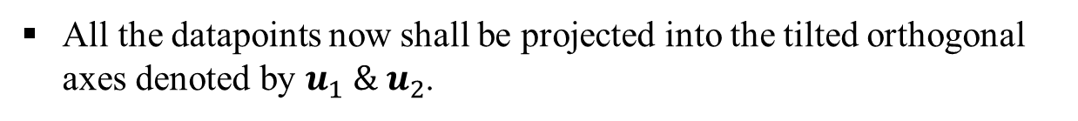


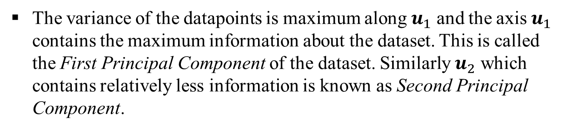

Principal Component Analysis
Intuition:
Consider the data points as shown in the figure beside.
Now let’s look at the dataset from a different perspective.
Note that the principal components are linear combinations of original basis of the dataset. Hence, it PCA is a linear feature extraction technique.

Slide 5
Standardization Of Data
Why Standardization or Normalization is required for PCA?
Usually the dataset contains variables / feature which are in different units of measurement. For example weight of a person measured in kg and blood sugar level in mg/dL.
Now if the unit of weight is changed to gram then the weight column would now contain values which is simply thousand times the weights in kg.
Thus few variables whose values are high in range will now dominate principal component and give the misleading directions of principal components.
Hence, it is always advisable to perform normalization on the dataset before applying PCA. Normalization/ Standardization will make sure that all the data falls in the same scale.

Slide 6

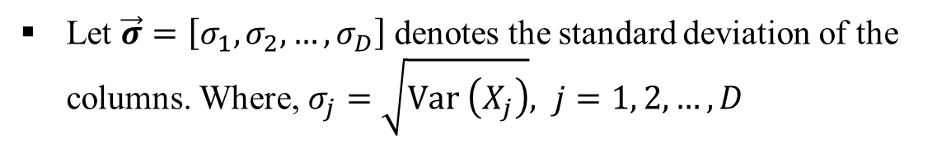
Standardization Of Data
Steps for standardizing the data
X₁ | X₂ | ... | X_{D}
x₁⁽¹⁾ | x₂⁽¹⁾ | ... | x_{D}⁽¹⁾
x₁⁽²⁾ | x₂⁽²⁾ | ... | x_{D}⁽²⁾
: | : | ... | :
x₁^{(n)} | x₂^{(n)} | ... | x_{D}^{(n)}
Make the dataset zero centred:
Make each column unit variance:
After normalization the covariance matrix of the normalized data simply becomes correlation matrix.

Slide 7

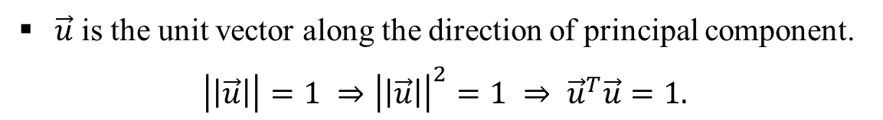





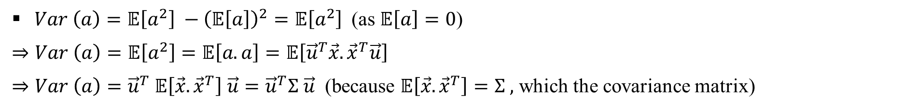
Variance Probe

Slide 8
PCA as Optimization Problem
This is a constraint optimization problem and we shall use Lagrange’s Multiplier Method to solve this.

Slide 9
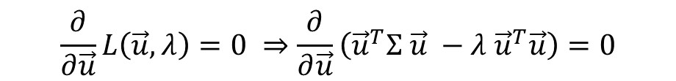
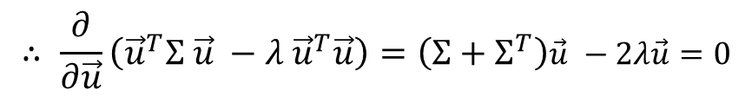
PCA as Optimization Problem
These equations are obtained from standard formula of Matrix Calculus
Thus, Principal Component Analysis simply reduced to an Eigenvalue problem. Here we have to find the eigenvalues and corresponding eigenvectors of covariance matrix of the normalized dataset.
We rank the eigenvalues in descending order (Note: all the eigenvalues are non-negative)

Slide 10


Principal Components
One interesting property of Eigenvectors / Principal Components:

Slide 11
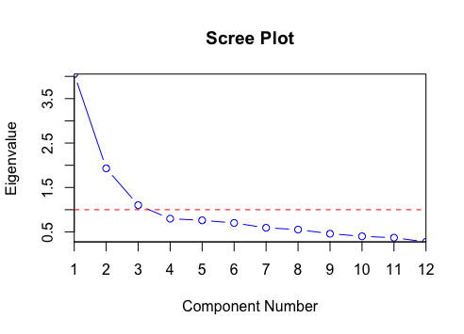
Scree Plot
Scree plot is a line plot of eigenvalues of correlation matrix in descending order.
Usually the along the first principal component the dataset shows maximum variance.
Scree plot is a monotonically decreasing plot and helps us to determine how many principal components are enough to faithfully represent the data without much loss of information.
Usually scree plot shows an elbow point. We consider those many components to represent our dataset, the rest of the components are discarded.

Slide 12
Steps of Principal Component Analysis
Steps at a glance:
Standardize the dataset.
Calculate the covariance matrix of the standardized dataset or correlation matrix of the dataset.
Order the eigenvectors by decreasing order of eigenvalues.
Number of principal components to retain would be the dimension of the transformed dataset.

Slide 13
Limitations of Principal Component Analysis
Limitations:
PCA works only for quantitative variables. For categorical variable it doesn’t work well.
PCA transforms the data from higher dimensional space to lower dimensional space using linear projections. If the data points lie on the complex manifold in higher dimensional space then PCA fails to work. Then we have to apply non-linear projection techniques.
Despite its limitations PCA works like charm in many cases. Hence, we shall use it often for feature extraction.

Slide 14
Thank You

